Slide 1
Buffalo Crime Data Analysis
Unveiling Trends and Insights for Enhancing Public Safety

Slide 2
Contents
Problem Statement
Data Collection
Data Cleaning and Preparation
Exploratory Data Analysis
Data Visualization
Results and Recommendations

Slide 3
Problem Statement
In recent years, Buffalo has experienced varying levels of criminal activity that impact community safety and resource allocation.
The purpose of this data analysis project is to identify trends and patterns in crime across different neighborhoods of Buffalo, assess the effectiveness of current crime prevention strategies, and recommend data-driven measures to local authorities for enhancing public safety and optimizing law enforcement efforts.

Slide 4
Data Collection
The data used for this project is open-source and available at Buffalo Crime Data.
The dataset consists of 31 columns and 300K rows.
Each row is a crime incident and contains details like case number, incident datetime, incident category, incident subcategory, location etc.

Slide 5
Data Cleaning and Preparation
The data is cleaned and prepared for further analysis using Python.
Fixing data types
Missing Values
Drop rows with null values in “Location”
Blank address and council district to be updated as "UNKNOWN“
Data Inconsistencies:
ASSAULT → Assault
ROBERY → Robbery
UNNOWN → UNKNOWN
Convert incident datetime from string to pandas datetime

Slide 6

Exploratory Data Analysis

Slide 7
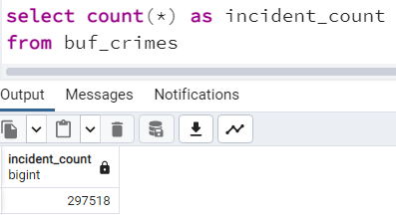
Total Incidents

Slide 8
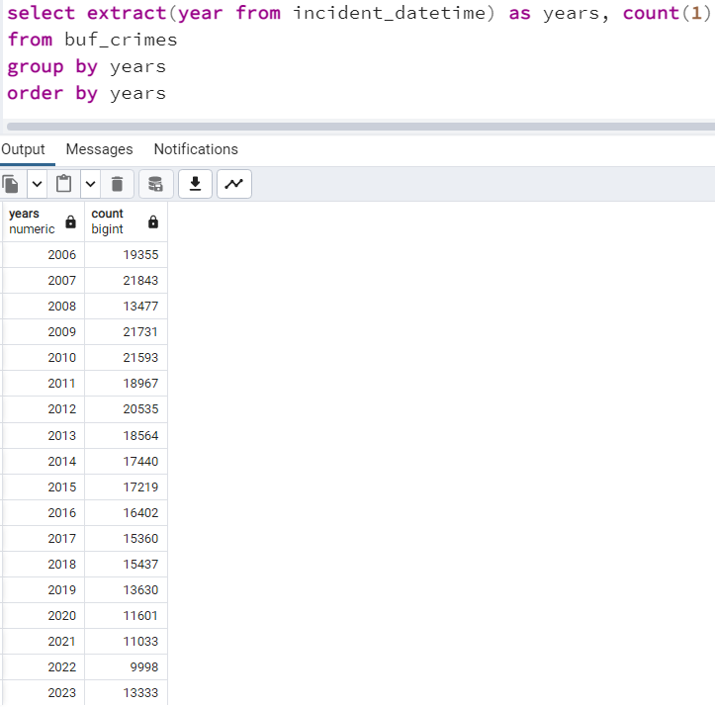
Year-wise Incidents

Slide 9
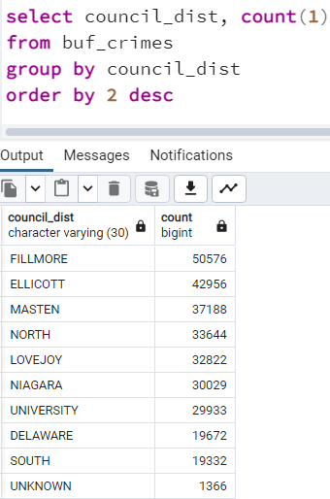
Incidents by Council District

Slide 10
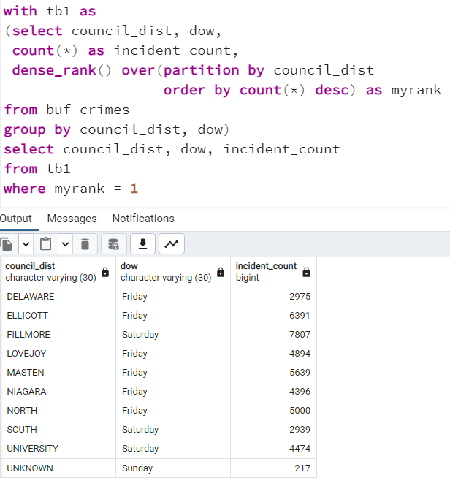
Peak Crime Days by District

Slide 11
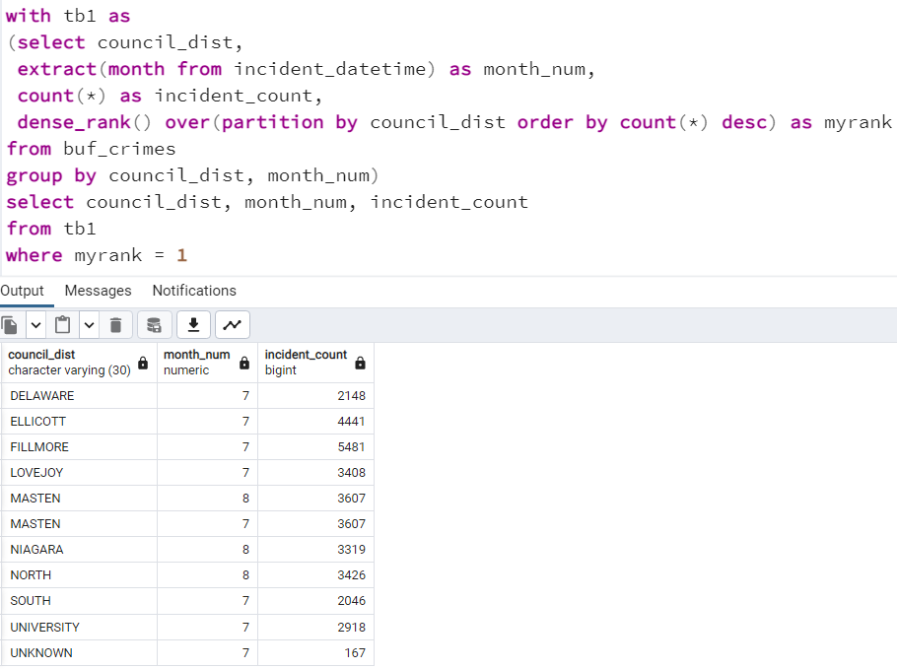
Peak Crime Months by District

Slide 12
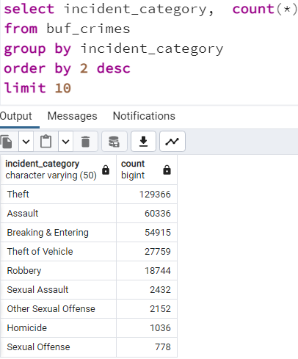
Top 10 Crime Categories

Slide 13
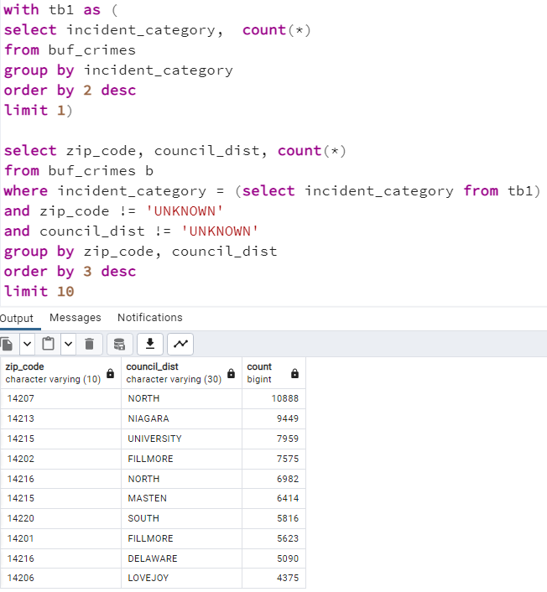
Geographic Breakdown of Most Frequent Crime

Slide 14
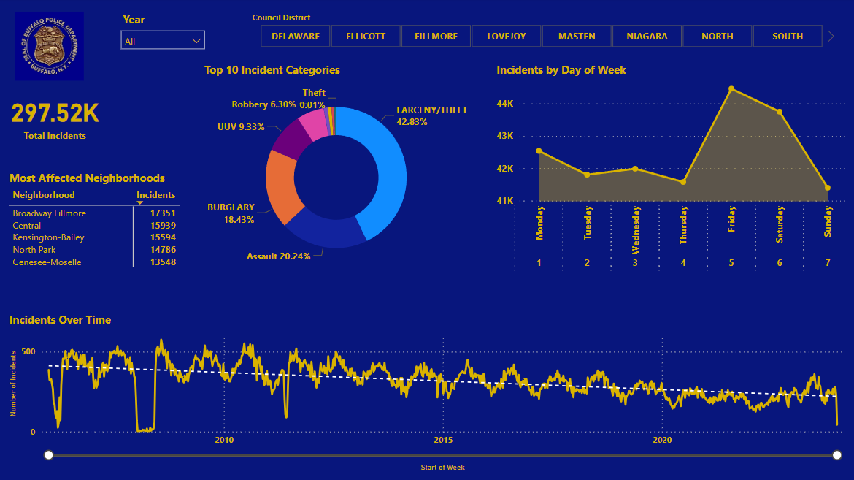
Data Visualization

Slide 15
Results
Most committed crime – Theft
Months with most crimes – July and August
Days with most crimes – Friday and Saturday

Slide 16
Recommendations
Increase police presence in Fillmore and Ellicott districts
Increase surveillance on Fridays and Saturdays
Additional policing effort in July and August

